Slide 1
Advanced Search

Slide 2
Constraint Satisfaction Problems (CSPs)
Search can be used to solve problems that are limited by constraints, such as the eight queens problem. Such problems are often known as Constraint Satisfaction Problems or CSPs.
A constraint satisfaction problem is a combinatorial optimization problem with a set of constraints.
Solution must be found that satisfies the constraints.
Combinatorial optimization problems involve assigning values to a number of variables
With many variables it is essential to use Heuristics.
CS 484 – Artificial Intelligence

Slide 3
Recognizing CSPs
Commutativity: order of application of any given set of actions has no effect on the outcome
Algorithms generate successors by considering possible assignments for only a single variable at each node in the search tree

Slide 4
Example: N - Queens Problem
Arrange N queens on a chess board in such a manner that none of them can attack any of the others! i.e.
No two queens are on the same row,
column or
diagonal.
We can solve such problems by constructing the complete decision tree and then find a path from its root to a leave that corresponds to a solution of the problem.
In many cases, the efficiency of this procedure can be dramatically increased by a technique called Backtracking (depth-first search).

Slide 5
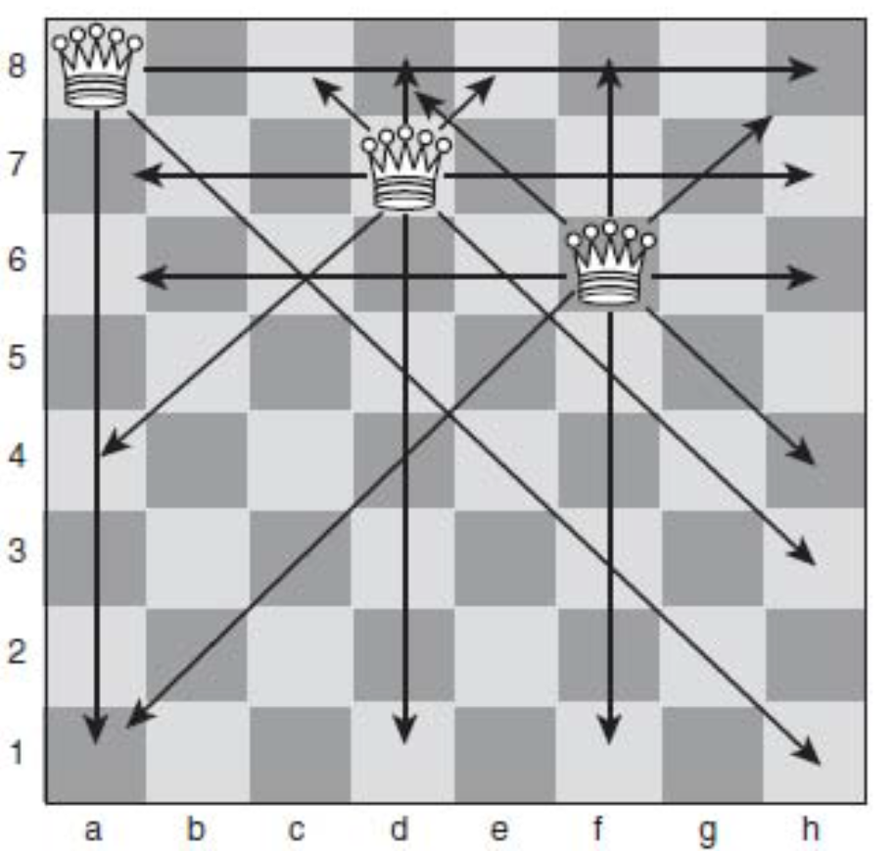
8 Queens Problem
CS 484 – Artificial Intelligence

Slide 6
Forward checking
After assigning X=value
  Look at unassigned neighbor-variables (Y)
  Delete from Y any value that is inconsistent with value chosen for X
 | CA | NV | UT | CO | NM | AZ
Init. domain | R G B | R G B | R G B | R G B | R G B | R G B
After CA=R | R* | G B | R G B | R G B | R G B | G B
After UT=G | R* | B | G* | R B | R G B | B
After NM=B | R* | B | G* | R | B*
CS 484 – Artificial Intelligence

Slide 7
Finding Arc Consistency
Consistency – for every value of X, there is some possible value of Y
Algorithm Puesdocode
Put all arcs in queue
While queue isn't empty
  If any inconsistencies in (X_{i}, X_{j}) (i.e. (CO, AZ)
    for each neighbor, X_{k}, of X_{i} other than X_{j}
      add (X_{k}, X_{i}) to the queue
CS 484 – Artificial Intelligence

Slide 8
Heuristic Repair
A heuristic method for solving constraint satisfaction problems.
Generate a possible solution, and then make small changes to bring it closer to satisfying constraints.
CS 484 – Artificial Intelligence

Slide 9
The Eight Queens Problem
A constraint satisfaction problem:
  Place eight queens on a chess board so that no two queens are on the same row, column or diagonal.
Can be solved by search, but the search tree is large.
Heuristic repair is very efficient at solving this problem.
CS 484 – Artificial Intelligence

Slide 10
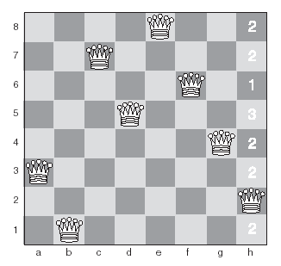
Heuristic Repair for The Eight Queens Problem
Initial state – one queen is conflicting with another.
We’ll now move that queen to the square with the fewest conflicts.
CS 484 – Artificial Intelligence

Slide 11
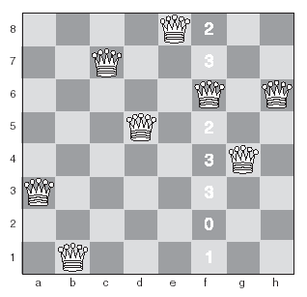
Heuristic Repair for The Eight Queens Problem
Second state – now the queen on the f column is conflicting, so we’ll move it to the square with fewest conflicts.
CS 484 – Artificial Intelligence

Slide 12
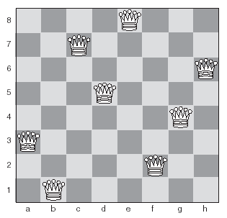
Heuristic Repair for The Eight Queens Problem
Final state – a solution!
CS 484 – Artificial Intelligence
Notes:
Real world combinatorial problems:
allocating teachers to classrooms
scheduling machines and workers in factories
selecting the best routes for buses , taxis, and other vehicles
traveling salesman problem

Slide 13
Local Search Algorithm
Start with the solutions randomly
Find the number of conflicts for each of the above solutions ( i.e. how many of the above have violated the constraints)
Select the solution that has lowest conflicts
Try to eliminate the conflicts
Repeat the procedure from step 2 until all the constraints are satisfied.
CS 484 – Artificial Intelligence

Slide 14
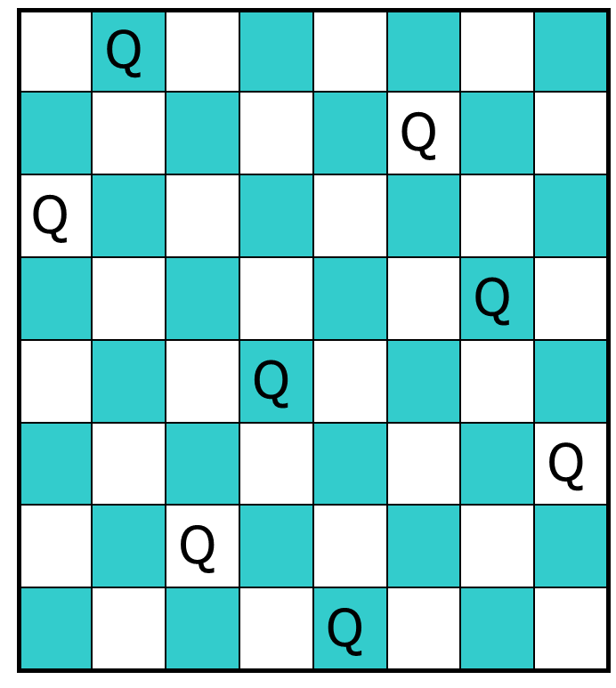
Local search Algorithm
CS 484 – Artificial Intelligence

Slide 15
Local Search
Like heuristic repair, local search methods start from a random state, and make small changes until a goal state is achieved.
Local search methods are known as meta-heuristics.
Most local search methods are susceptible to local maxima, like hill-climbing.
CS 484 – Artificial Intelligence
Notes:
Hill climbing is an example of local search
Other examples include neural networks, genetic algorithms, and simulates annealing (later)
Local optimization because often finds a local maxima rather than a global one

Slide 16
Exchanging Heuristics
A simple local search method.
Heuristic repair is an example of an exchanging heuristic.
Involves swapping two or more variables at each step until a solution is found.
A k-exchange involves swapping the values of k variables.
Can be used to solve the traveling salesman problem.
CS 484 – Artificial Intelligence

Slide 17
Iterated Local Search
A local search is applied repeatedly from different starting states.
Attempts to avoid finding local maxima.
Useful in cases where the search space is extremely large, and exhaustive search will not be possible.
CS 484 – Artificial Intelligence

Slide 18
Simulated Annealing
Combination of hill climbing and a random walk
In metallurgy, annealing - heat metal and then cooled very slowly
Aims at obtaining a minimum value for some function of a large number of variables.
  This value is known as the energy of the system.
CS 484 – Artificial Intelligence
Notes:
annealing make metal strong
imagine bumpy surface – want ping-pong ball to be in the deepest crevice
let ball roll, finds local minima (like random walk)
shack the table, bounce the ball out of local minima, but not hard enough to dislodge from global minima
in simulated annealing – start shaking hard and then gradually reduce intensity of shakes

Slide 19
Simulated Annealing (2)
A random start state is selected
A small random change is made.
  If this change lowers the system energy, it is accepted.
  If it increases the energy, it may be accepted, depending on a probability called the Boltzmann acceptance criteria:
    e^{(∆E/T)}
CS 484 – Artificial Intelligence

Slide 20
Simulated Annealing (3)
e^{(∆E/T)}
  T is the temperature of the system
  ∆E is the change in energy.
When the process starts, T is high, meaning increases in energy are relatively likely to happen.
Over successive iterations, T lowers and increases in energy become less likely.
CS 484 – Artificial Intelligence

Slide 21
SIMULATED-ANNEALING(problem, schedule) returns a solution state {
current ← InitialState(problem)
for t ← 1 to ∞ do
T ← schedule[t]
if T = 0 then return current
next ← a randomly selected successor of
current
∆E ← next.value – current.value
if ∆E > 0 then current ← next
else current ← next only with probability e^{∆E/T}
CS 484 – Artificial Intelligence
Notes:
problem = a problem
schedule – a mapping form time to "temperature"
Probability decreases exponentially with the "badness" of the move
One can prove that if the schedule lowers T slowly enough, the algorithm will find a global optimum with probability approaching 1.
schedule chosen with care – initial temperature should make uphill and downhill transition probabilities about the same (need to know average difference between 2 random states)
decrease by a fixed alpha < 1 so that temperature is 0 at the end of the allotted time.

Slide 22
Simulated Annealing (4)
Because the energy of the system is allowed to increase, simulated annealing is able to escape from global minima.
Simulated annealing is a widely used local search method for solving problems with very large numbers of variables.
For example: scheduling problems, traveling salesman, placing VLSI (chip) components.
CS 484 – Artificial Intelligence

Slide 23
Genetic Algorithms
A method based on biological evolution.
Create chromosomes which represent possible solutions to a problem.
The best chromosomes in each generation are bred with each other to produce a new generation.
Much more detail on this later.
CS 484 – Artificial Intelligence

Slide 24
Iterative Deepening A*
A* is applied iteratively, with incrementally increasing limits on f(n).
Works well if there are only a few possible values for f(n).
The method is complete, and has a low memory requirement, like depth-first search.
CS 484 – Artificial Intelligence

Slide 25
Parallel Search
Some search methods can be easily split into tasks which can be solved in parallel.
Important concepts to consider are:
  Task distribution
  Load balancing
  Tree ordering
CS 484 – Artificial Intelligence

Slide 26
Bidirectional Search
Also known as wave search.
Useful when the start and goal are both known.
Starts two parallel searches – one from the root node and the other from the goal node.
Paths are expanded in a breadth-first fashion from both points.
Where the paths first meet, a complete and optimal path has been formed.
Milan to Naples w/ knowledge "All roads lead to Rome"
CS 484 – Artificial Intelligence

Slide 27
Nondeterministic Search
Useful when very little is known about the search space.×
Combines the depth first and breadth first approaches randomly.
Avoids the problems of both, but does not necessarily have the advantages of either.
New paths are added to the queue in random positions, meaning the method will follow a random route through the tree until a solution is found.
CS 484 – Artificial Intelligence

Slide 28
How can we build machines that act rationally ?
def act_rationally:
for actions in all_actions():
score = score(action)
if score > best_score:
best_score = score
best_action = action
execute(best_action)
CS 484 – Artificial Intelligence

